Slide 1




AI-ASSISTED PROCESSOR PERFORMANCE OPTIMIZATION
CSA1205 - Computer Architecture
PRESENTED BY
192521117_R.MOHANRAM
192521351_P. LOGESH
192521386_S. MOHAMED JILAN
GUIDED BY
Dr.Vijaya Bhaskar K

Slide 2

INTRODUCTION
Modern computers continuously handle varying workloads.
CPU, memory, disk, and network resources change dynamically.
Poor resource utilization can lead to:
Performance degradation
Unnecessary energy consumption
High memory usage
System slowdowns
This project uses Machine Learning + Real-Time Monitoring + AI Decision Making to analyze processor workload
The system provides optimization recommendations based on the predicted workload.

Slide 3
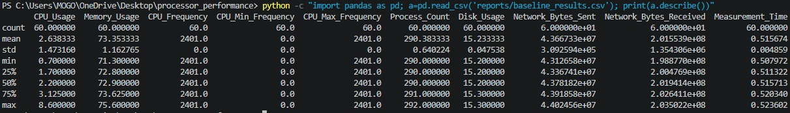
PROBLEM STATEMENT
Modern computer systems experience varying CPU, memory, disk, and network workloads.
Traditional processor monitoring mainly reports system statistics but does not intelligently classify workload conditions or provide adaptive recommendations.
Problem identified
CPU workload changes dynamically.
High resource utilization can affect performance.
Low workloads may waste energy through unnecessary background activity.
Manual monitoring does not provide intelligent workload classification.
A machine-learning-based decision system is required for real-time optimization.

Slide 4
Literature Review
S.No. | Year | Authors | Paper / Research Area | Key Contribution
1 | 2018 | David Brooks et al. | Dynamic Voltage and Frequency Scaling | Explored processor frequency and voltage management for reducing power consumption.
2 | 2019 | Y. Wang et al. | Machine Learning for CPU Performance Optimization | Used ML techniques to predict processor performance under different workloads.
3 | 2020 | J. Chen et al. | AI-Based Resource Management | Applied intelligent resource allocation to improve computing efficiency.
4 | 2021 | A. Singh et al. | ML-Based Workload Prediction | Predicted workload conditions to support dynamic system optimization.
5 | 2022 | S. Mittal | Machine Learning for Energy-Efficient Computing | Investigated ML-based techniques for improving performance while reducing energy consumption.
6 | 2023 | R. Kumar et al. | AI-Assisted Processor Optimization | Demonstrated AI-driven workload analysis and adaptive processor management.

Slide 5



OBJECTIVES
Collect real-time processor performance data.
Build a real-world processor monitoring dataset.
Classify workload into:
LOW
MODERATE
HIGH
Train a Random Forest machine-learning model.
Develop an AI decision engine.
Generate workload-based optimization recommendations.
Perform baseline and optimized processor experiments.
Compare processor performance before and after AI-assisted monitoring.
Develop a real-time web dashboard.
STAGE 01
SYSTEM
Maps raw processor state vectors and initializes background hardware diagnostic tracking loops.
STAGE 02
DATA COLLECTION
Captures real-time micro-architectural counters, branch histories, and execution profiles.
STAGE 03
DATASET
Aggregates, clean-filters, and structures raw execution telemetry into dense multidimensional tensors.
STAGE 04
ML MODEL
Evaluates complex predictive execution paths using localized ultra-lightweight regression matrices.
STAGE 05
AI ENGINE
Identifies architectural resource hazards, critical hot-spots, and scheduling stalls dynamically.
STAGE 06
OPTIMIZATION
Dispatches predictive runtime microcode parameter overrides and dynamic voltage scaling paths.
STAGE 07
DASHBOARD
Streams real-time metrics, instruction-per-clock metrics, and safe thermal thresholds visually.
STAGE 08
PERFORMANCE
Audits execution acceleration deltas against hard baselines to continuously verify clock stability.

Slide 6
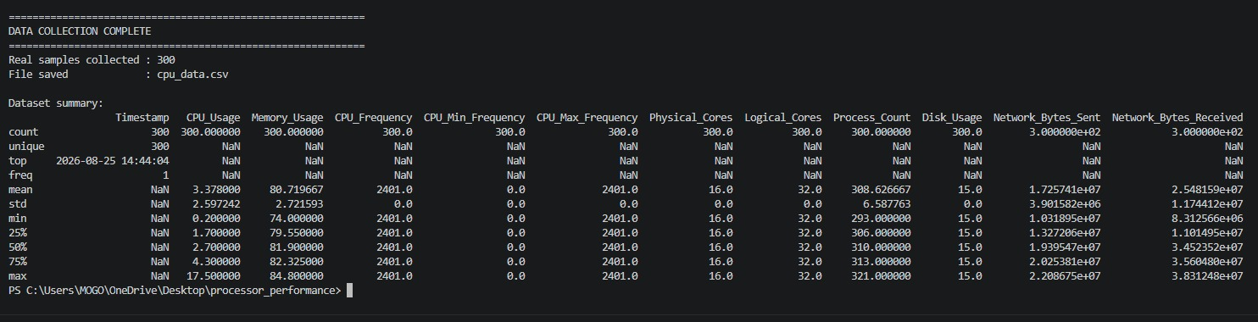
MODULE 1: Data Collection
Real-Time Data Collection
The first module collects real processor and system information using Python and psutil .
Parameters Collected
CPU Usage
Memory Usage
CPU Frequency
Minimum CPU Frequency
Maximum CPU Frequency
Physical Cores
Logical Cores
Process Count
Disk Usage
Network Bytes Sent
Network Bytes Received
Technology Used
Python + psutil + Pandas
Screenshot

Slide 7
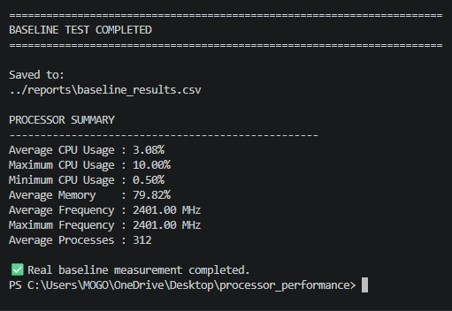
MODULE 1: Baseline Performance Measurement
A baseline experiment was performed before AI-assisted optimization.

Slide 8
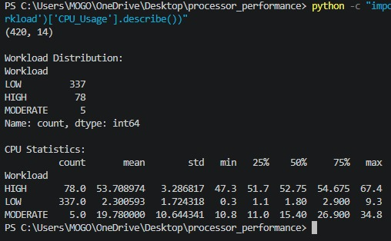
MODULE 2: Dataset Preparation
Machine Learning Dataset Preparation
Real system measurements were combined to create the ML dataset.
Dataset
Total Samples: 420
Baseline samples: 300
Controlled workload samples: 120
Workload Distribution
CPU Usage
LOW → Average 2.14%
MODERATE → Average 20.83%
HIGH → Average 52.76%
Workload | Samples
LOW | 337
MODERATE | 5
HIGH | 78

Slide 9
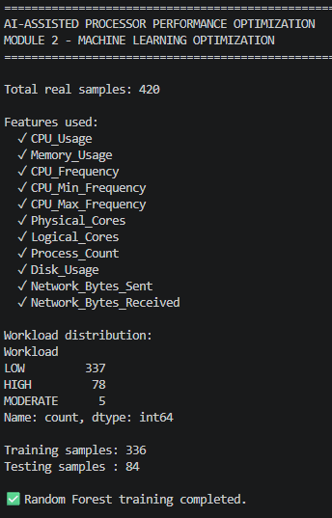
MODULE 2: RANDOM FOREST MODEL
Random Forest Workload Classification
A Random Forest classifier was trained using real processor measurements.
ML Features
CPU Usage
Memory Usage
CPU Frequency
CPU Min Frequency
CPU Max Frequency
Physical Cores
Logical Cores
Process Count
Disk Usage
Network Bytes Sent
Network Bytes Received
Dataset Split
Training: 336 samples
Testing: 84 samples
Model Performance
Accuracy = 98.81%

Slide 10
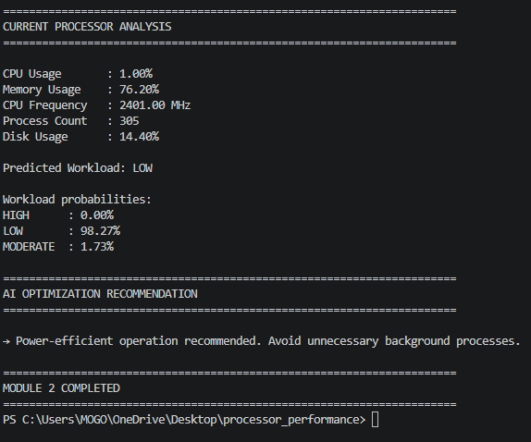
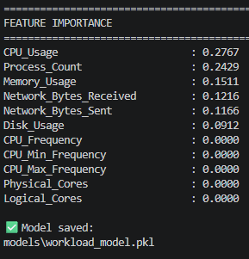
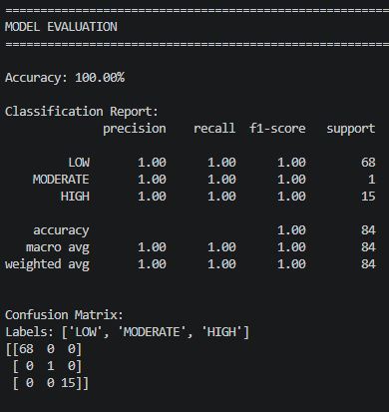
MODULE 2: FEATURE IMPORTANCE
Feature Importance Analysis
The Random Forest model identifies which system parameters contribute most to workload classification.
Other features had negligible importance in the trained model.
Key Finding
CPU Usage is the most influential feature for workload classification.

Slide 11
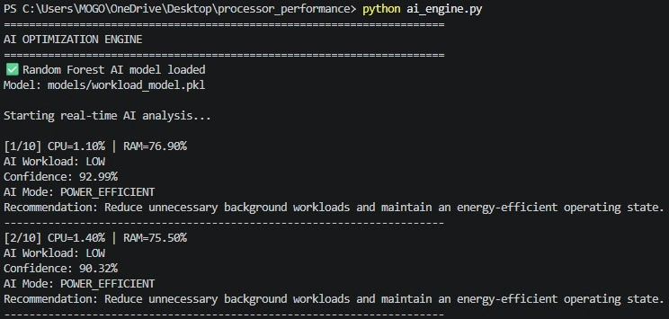
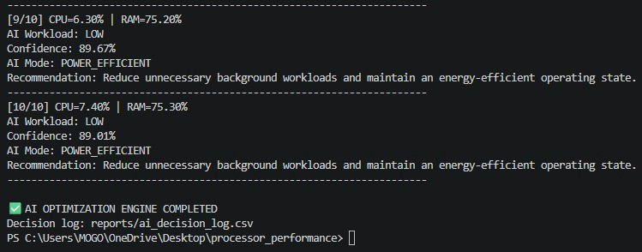
MODULE 3: AI Decision Engine
The trained Random Forest model is integrated into a real-time AI engine.
AI Processing Flow:
System Metrics
↓
Random Forest Prediction
↓
Workload Classification
↓
Confidence Calculation
↓
AI Decision
↓
Optimization Recommendation
AI Workload Classes
🟢 LOW → Power Efficient
🟡 MODERATE → Balanced
🔴 HIGH→ Performance

Slide 12
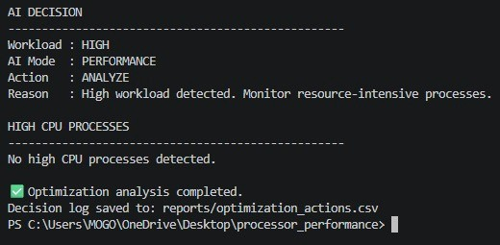
MODULE 3: AI-Assisted Optimization
The optimization engine converts ML workload predictions into processor-management recommendations
Workload | AI Mode | Action
LOW | POWER_EFFICIENT | MONITOR
MODERATE | BALANCED | BALANCE
HIGH | PERFORMANCE | OPTIMIZE
Additional Conditions
CPU ≥ 80% → HIGH CPU ALERT
Memory ≥ 90% → MEMORY ALERT
Resource-intensive processes are monitored
The system performs software-level monitoring and recommendations without changing CPU voltage, BIOS settings, or hardware clock parameters.

Slide 13
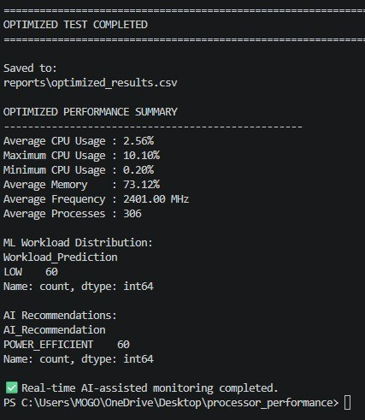
MODULE 3: OPTIMIZED TEST
AI-Assisted Optimized Performance Test
The optimized experiment collected 60 real-time samples while the ML model classified the workload.
Parameter | AI-Assisted
Average CPU Usage | 2.59%
Maximum CPU Usage | 8.10%
Minimum CPU Usage | 0.50%
Average Memory | 71.09%
Average Frequency | 2401 MHz
Average Processes | 291.12
ML Output
The system continuously predicts:
LOW / MODERATE / HIGH
and generates the corresponding recommendation.

Slide 14
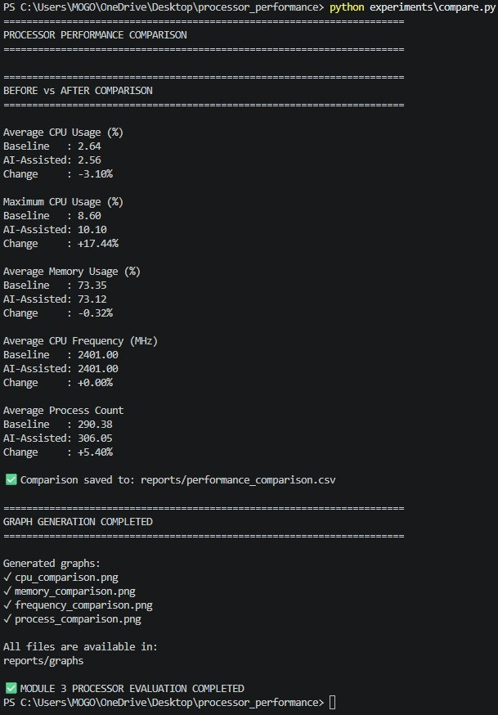
Before vs After AI-Assisted Monitoring
Metric | Baseline | AI-Assisted | Change
Average CPU | 2.64% | 2.59% | −1.83%
Maximum CPU | 8.60% | 8.10% | −5.81%
Average Memory | 73.35% | 71.09% | −3.09%
Average Frequency | 2401 MHz | 2401 MHz | 0%
Processes | 290.38 | 291.12 | +0.25%
Key Observation
AI-assisted monitoring resulted in:
Lower average CPU utilization.
Lower maximum CPU utilization.
Lower average memory utilization.
Stable CPU frequency.
No significant reduction in system responsiveness indicated by process count..

Slide 15

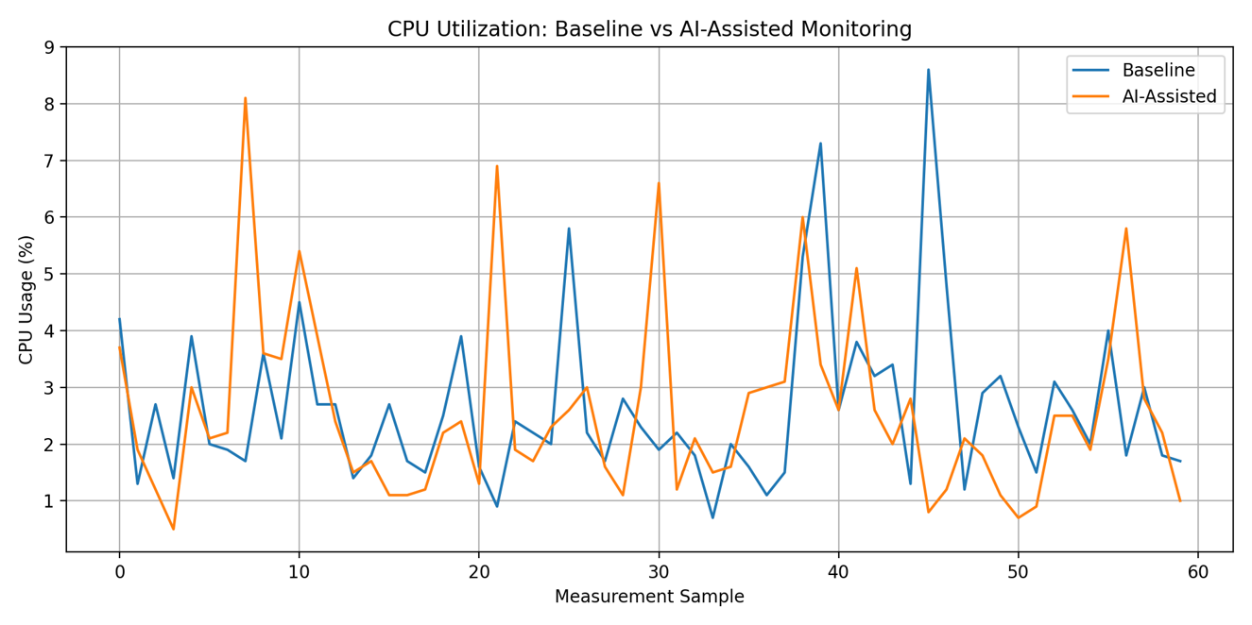
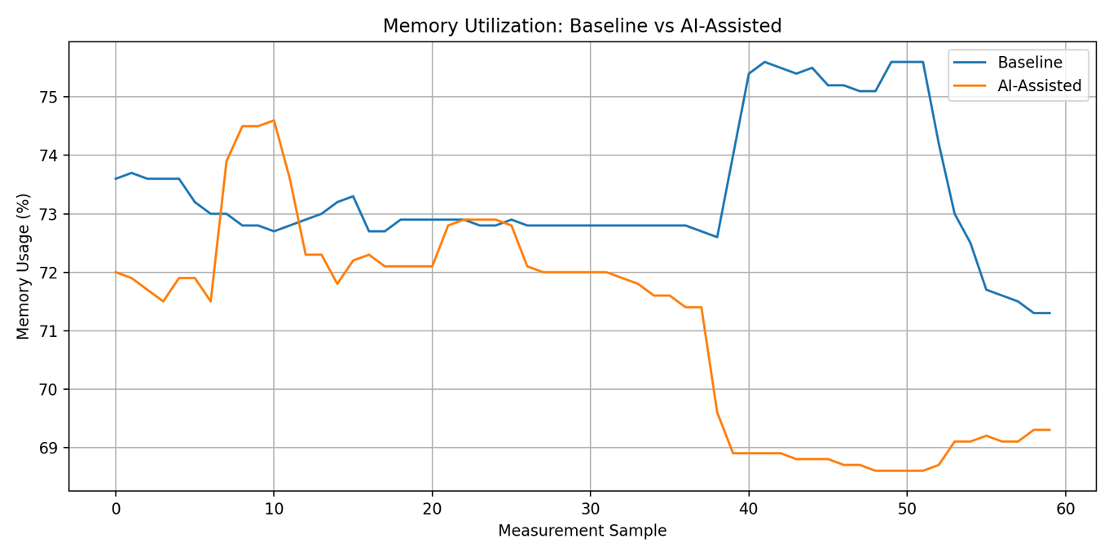
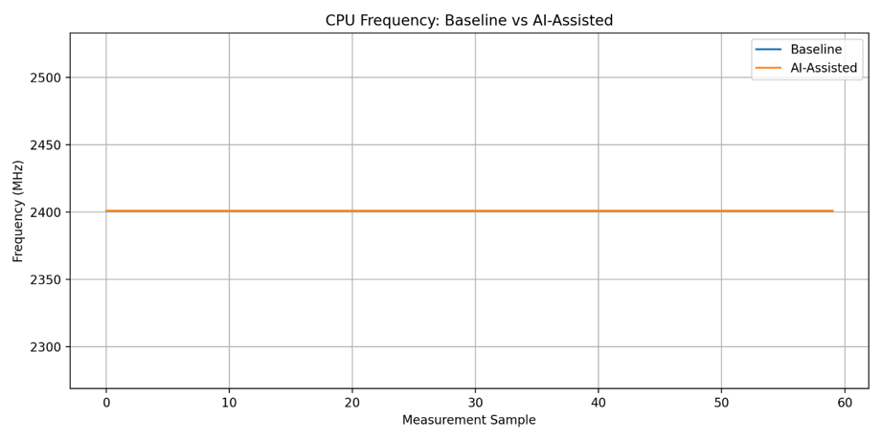
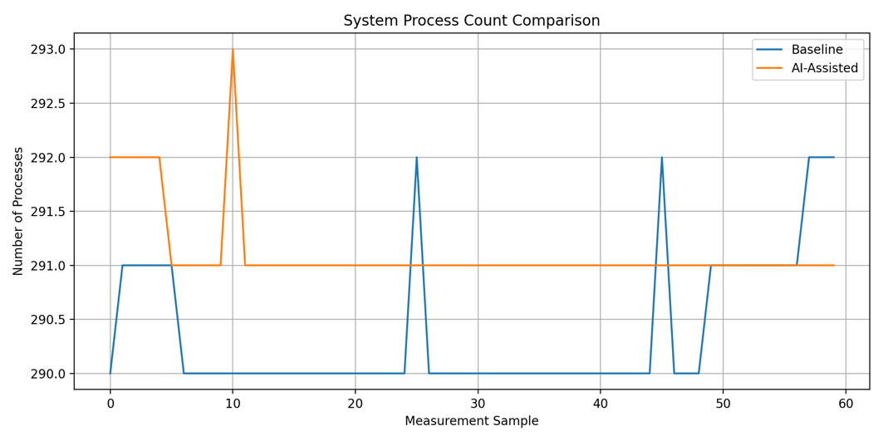
Performance Comparison Graphs

Slide 16
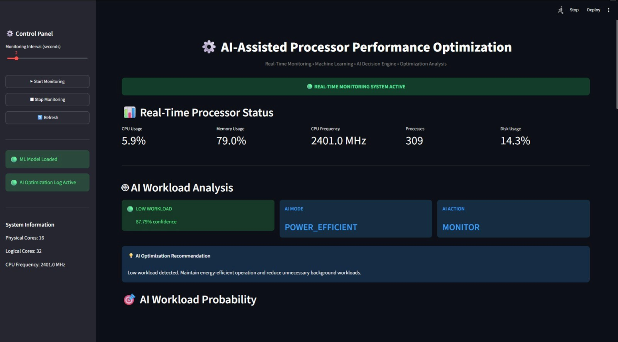
Real-Time AI Dashboard
A Streamlit dashboard provides a graphical interface for real-time processor monitoring and AI decisions.
Dashboard Features:
Real-time CPU monitoring
Memory monitoring
CPU frequency
Process count
Disk usage
ML workload classification
AI confidence
AI mode
AI action
Workload probability
Resource-intensive processes
Real-time performance graph
AI decision logs
Optimization logs.

Slide 17
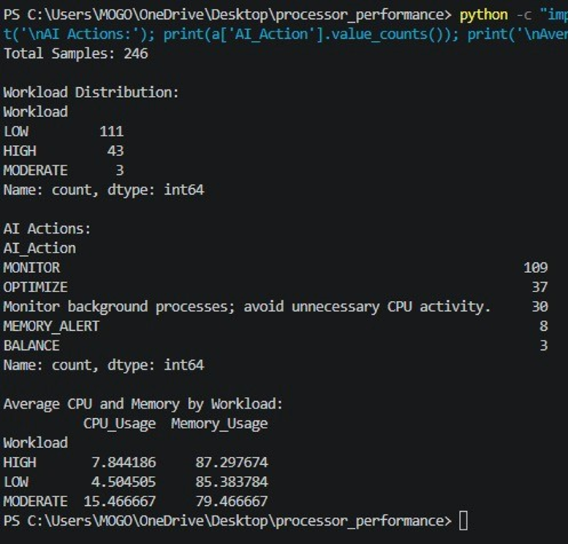
AI Decision and Optimization Logs
The system records AI decisions continuously for analysis and evaluation.
Recorded Information:
Timestamp
CPU Usage
Memory Usage
CPU Frequency
Process Count
Disk Usage
Workload Prediction
Confidence
AI Mode
AI Action
Recommendation
Actual AI Results
From the collected AI decision log:
224 recorded samples
Workload classifications:
LOW → 102
HIGH → 43
AI actions included:
MONITOR → 100
OPTIMIZE → 37
MEMORYALERT →8

Slide 18
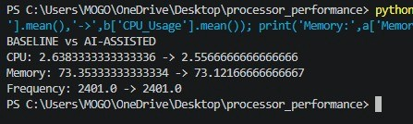
Results and Conclusion
Results
Real-time processor dataset successfully collected.
420 real samples prepared for machine learning.
Random Forest achieved 98.81% classification accuracy.
AI engine successfully classified processor workload.
AI generated workload-dependent optimization recommendations.
Real-time Streamlit dashboard successfully integrated
Conclusion
The proposed AI-Assisted Processor Performance Optimization System combines real-time system monitoring, machine learning, and an AI decision engine to intelligently analyze processor workloads.
The experimental results demonstrate reduced CPU and memory utilization during the AI-assisted monitoring phase while maintaining stable CPU frequency.
The system provides an intelligent foundation for adaptive, workload-aware processor performance optimization
Performance Improvement
Average CPU:
2.64% → 2.59%
Maximum CPU:
8.60% → 8.10%
Average Memory:
73.35% → 71.09%

Slide 19
REFERENCES
[1] D. Brooks et al., “Dynamic voltage and frequency scaling techniques for processor power management,” 2018.
[2] Y. Wang et al., “Machine learning approaches for CPU performance optimization,” 2019.
[3] J. Chen et al., “AI-based resource management for computing systems,” 2020.
[4] A. Singh et al., “Machine learning based workload prediction for system optimization,” 2021.
[5] S. Mittal, “Machine learning techniques for energy-efficient computing,” 2022.
[6] R. Kumar et al., “AI-assisted processor performance optimization and workload management,” 2023

Slide 20


THANK YOU

